Slide 1
ROBOTICS
Exploring the Past, Present, and Future
Name: Kasturi Mahendra Sawant
MCA-SANDWICH

Slide 2
INTRODUCTION TO ROBOTICS
In today's world, robotics is not just a concept but a reality. This presentation explores how technology is integrated into our everyday lives through robotics. We will examine various applications and their impact on society.

Slide 3
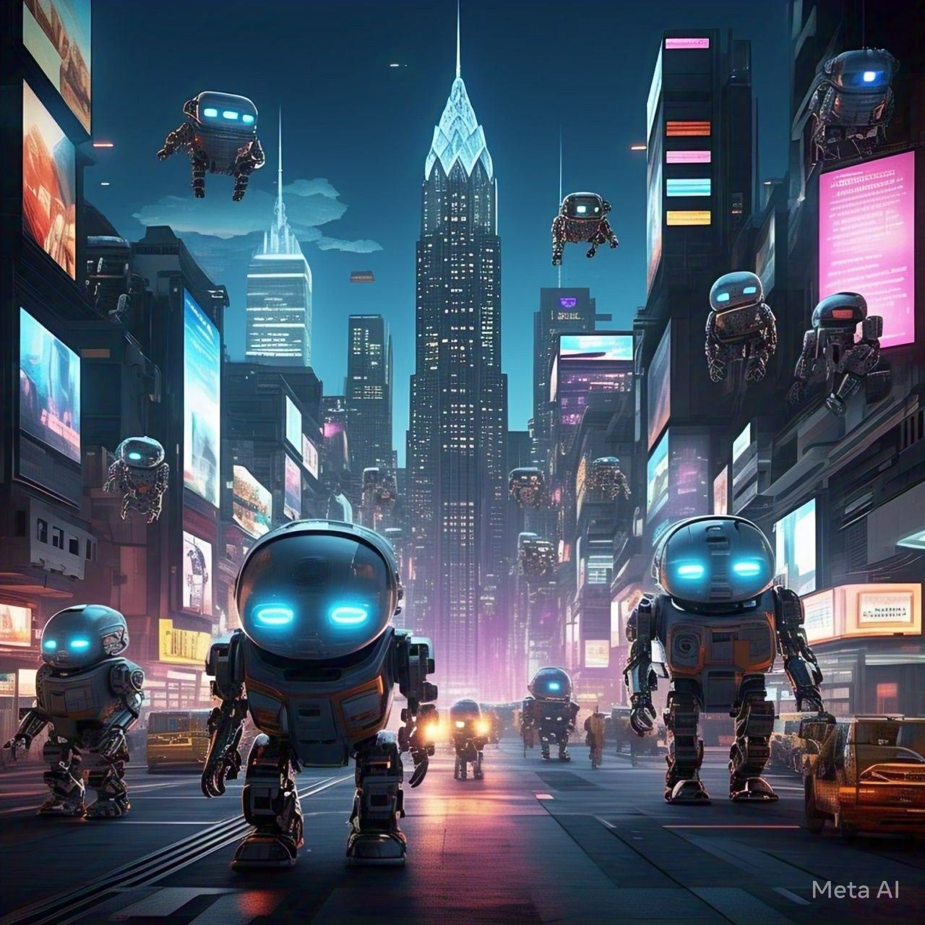
History of robotics
The journey of robotics began in the early 20th century. From simple machines to advanced AI-driven robots, the evaluation showcases significant milestones that have shaped modern robotics technology

Slide 4
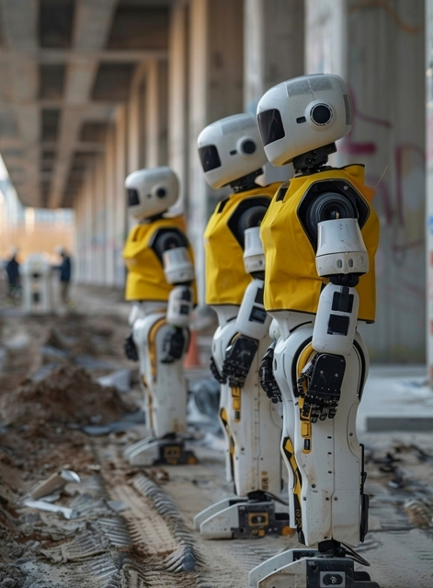
TYPES OF ROBOTICS
Industrial Robots
Service Robots
Humanoid Robots
Mobile Robots
Medical Robots
Agricultural Robots

Slide 5
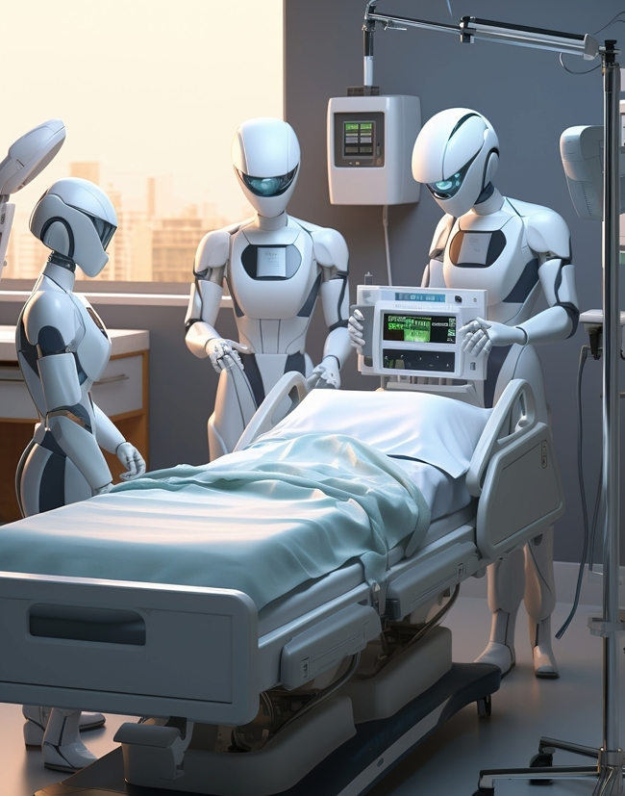
ROBOTS IN HEALTHCARE
In the healthcare sector, robots assist in surgeries, patient care, and rehabilitation. Their precision and efficiency lead to better healthcare sector, robots assist in surgeries, patient care, and rehabilitation. Their precision and efficiency lead to better patient outcomes and allow healthcare professionals To focus on critical tasks.

Slide 6
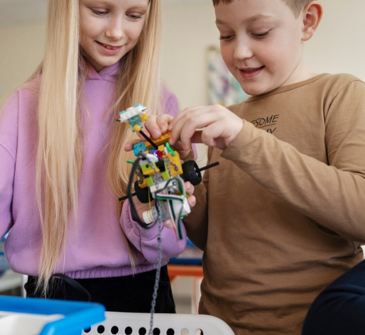
Robotics IN EDUCATION
Educational robots promote STEM learning and critical thinking among students. By engaging with robotics, learners develop skills that are essential for future careers in technology and engineering fields.

Slide 7

IMPACT ON EMPLOYMENT
While robotics brings While robotics brings efficiency, it also raises concerns about job displacement. Understanding the balance between efficiency, it also raises concerns about job displacement. Understanding the balance between automation and employment is crucial for a sustainable future in the workforce.

Slide 8
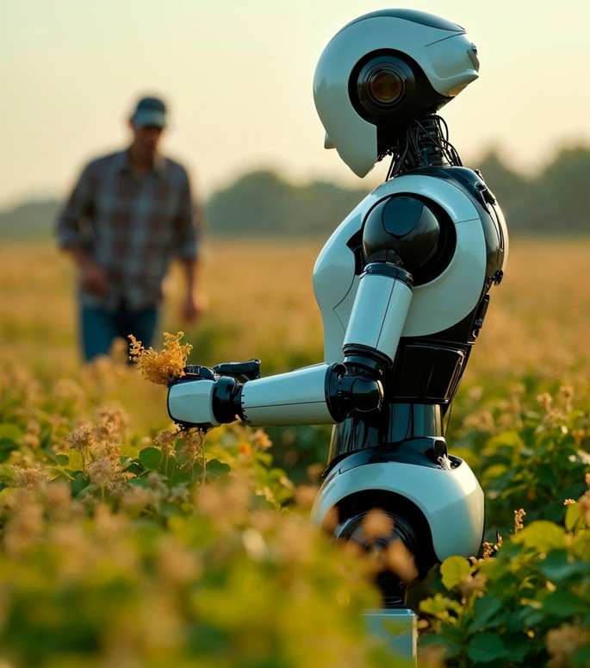
ROBOTICS IN AGRICULTURE
Agricultural robots assist in planting, harvesting, and monitoring crops. These innovations lead to increased productivity and sustainability, helping to address the challenges of food security.

Slide 9
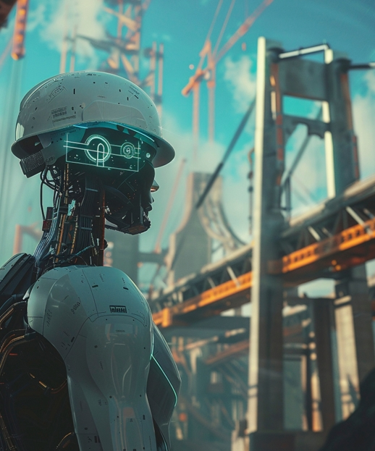
CHALLENGES IN ROBOTICS
Despite advancements, the field of robotics faces challenges such as ethical concerns, high costs, and technical limitations. Addressing these issues is vital for the widespread adoption of robotic technologies.

Slide 10
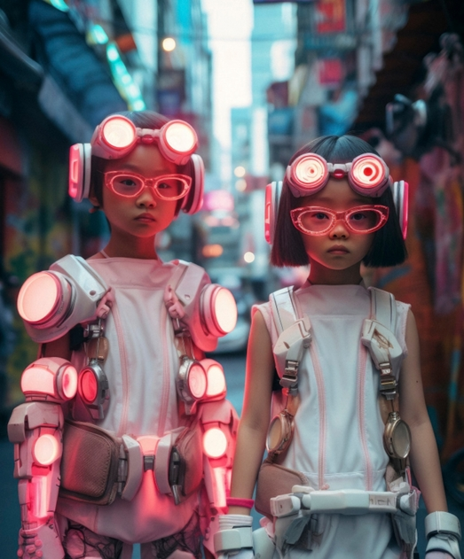
FUTURE OF ROBOTICS
The Future of robotics is promising, with advancements in AI, machine learning, and automation. We can expect more intelligent and capable robots that will further integrate into our daily lives, enhancing our Experiences.

Slide 11

CONCLUSION
“Robotics has grown from simple machines of the past to advanced helpers of today, and in the future, it promises to reshape the way we live and work. It is both a challenge and an opportunity, reminding us that technology should serve humanity, not replace it

Slide 12
THANK YOU

